Slide 1
IBM Capstone Project Open a Chinese Restaurant in Toronto, Canada
Ruoyu Zhang

Slide 2

Introduction
Toronto is one of the most diverse cities in the world. The local residents come from more than 100 nationalities and speak more than 140 different languages. Toronto has the largest Chinese ethnic group outside of Asia, and the Chinese restaurant here gathers Sichuan, Hunan, Cantonese and even northern dishes. These Chinese restaurants are located in Chinatown in the city center, as well as Scarborough, Richmond Hill, Markham and Mississauga in the north. Chinese cuisine attracts many tourists and local residents in Toronto.

Slide 3
Business Understanding
The objective of this project is to find the most suitable location for the client to open a Chinese restaurant in Toronto. I will use machine learning skills such as K-means to analyse data extracted from various sources to find the best solution for my client. My target audience is entrepreneur who wants to open a Chinese restaurant in Toronto, and need suggestions on the best location to operate the restaurants.

Slide 4
Data
Neighborhoods data
Scrapping list of neighborhoods in Toronto from Wikipedia.
Latitude and Longitude data
Getting the geographical coordinates data of each postal code from a csv file.
Venue data
Getting venue data from Foursquare API.

Slide 5
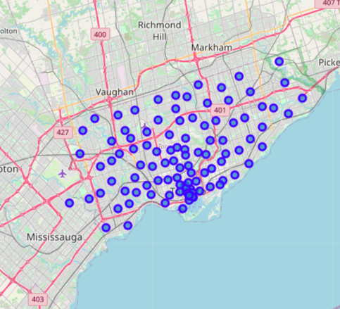
Methodology --- Data Visualization
Map of Toronto along with the marked coordinates of its neighborhoods.

Slide 6
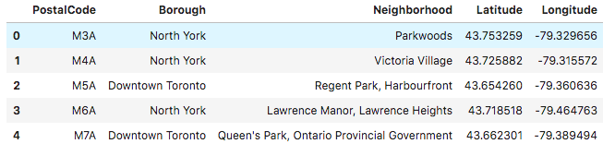
Methodology --- Foursquare API
List of top 100 venues within 500 meters around each coordinates

Slide 7
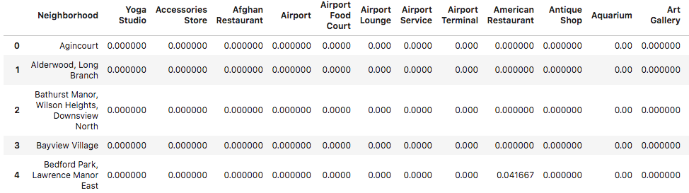
Methodology --- One-hot Encoding
One hot encoding is a process by which categorical variables are converted into a form that could be provided to machine learning algorithms to do a better job in prediction.

Slide 8
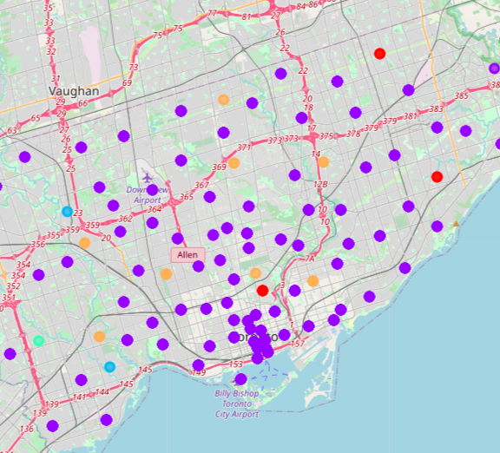
Methodology --- Clustering
The K-means algorithm identifies 5 number of centroids, and then allocates every data point to the nearest cluster, while keeping the centroids as small as possible.

Slide 9
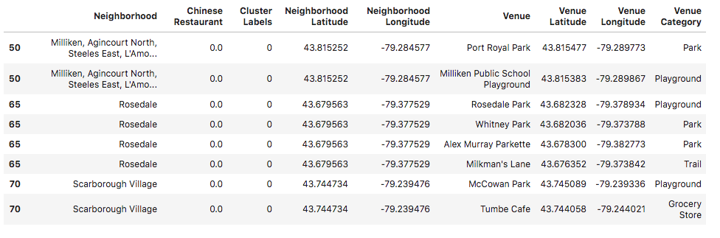
Results --- Cluster 0

Slide 10
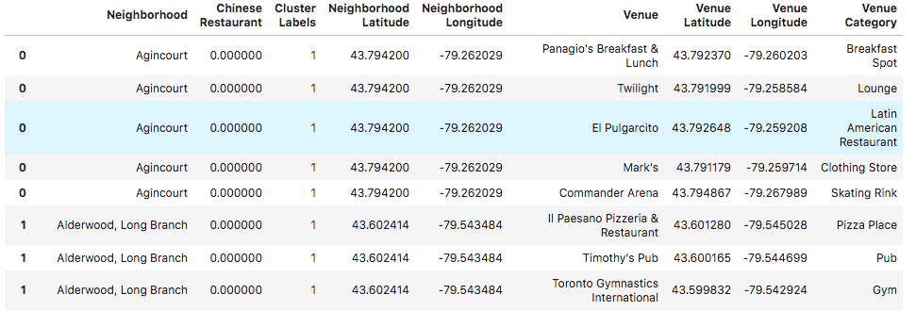
Results --- Cluster 1

Slide 11
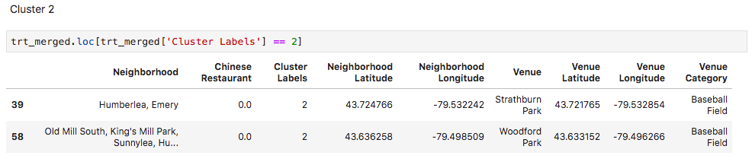
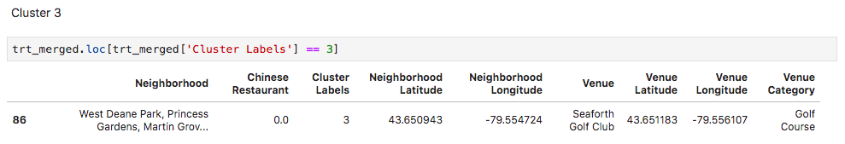
Results --- Cluster 2 & 3

Slide 12
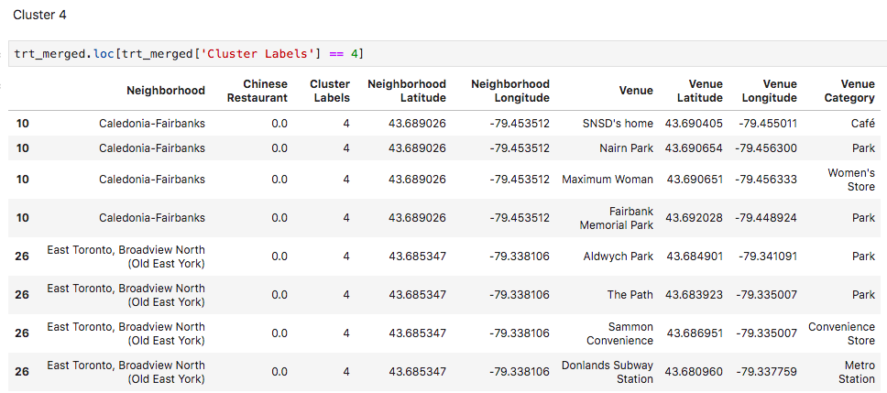
Results --- Cluster 4

Slide 13
Discussion
After examining five clusters, cluster 1 has the most Chinese restaurants such as Bayview Village, North Toronto Wes, etc. The cluster results suggests that the client can open a Chinese restaurant in potential neighborhoods with less Chinese restaurant. Cluster 4 has several good potential neighborhoods because they are close to cluster but have no Chinese restaurant. This way, client can gain profit while minimize competition.

Slide 14
Conclusion
In this project, I discussed the potential location for an entrepreneur to open a Chinese restaurant in Toronto, Canada. I used neighborhood data, geographical corrdinates data, and Foursquare API to create a map of Toronto. Then used machine learning algorithm to predict the potential location for the client. One improvement could be include population density to my model, which can increase the overall prediction accuracy.

Slide 15
Thank you!

